Slide 1
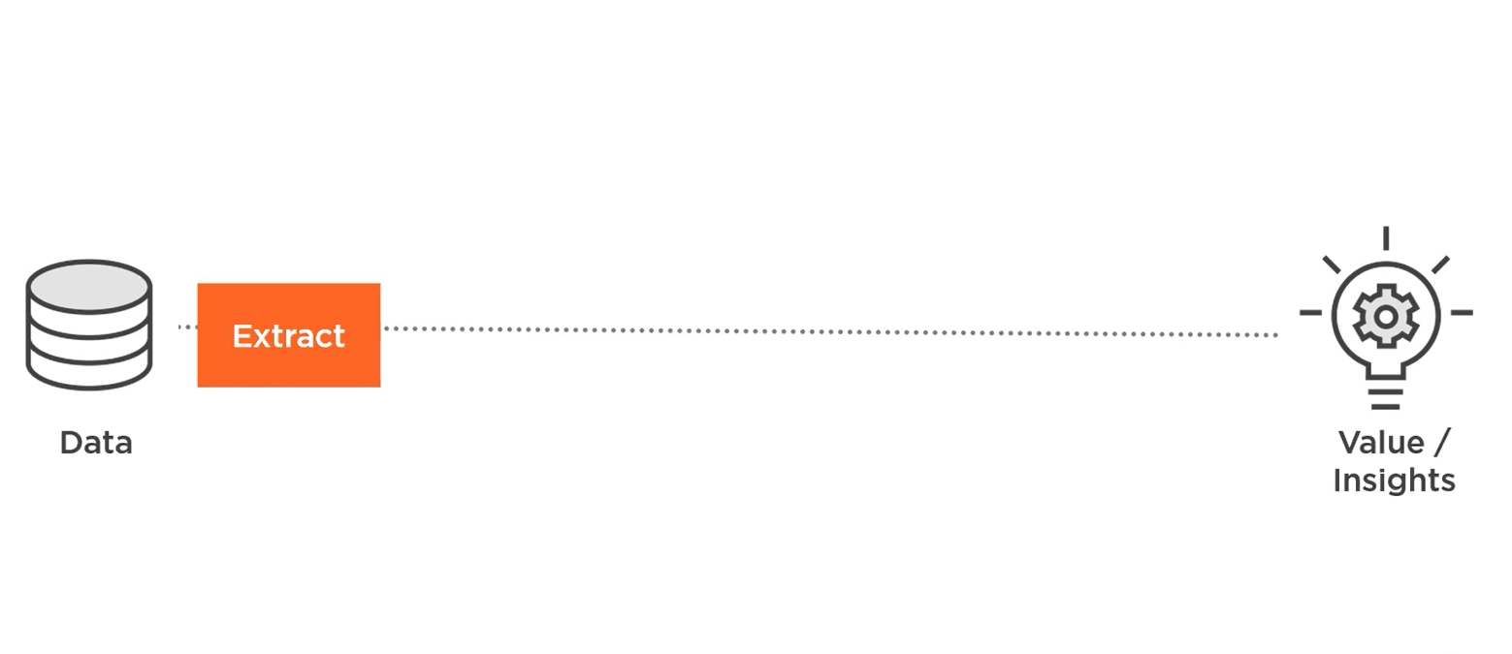
Data Science Project Cycle Overview

Slide 2
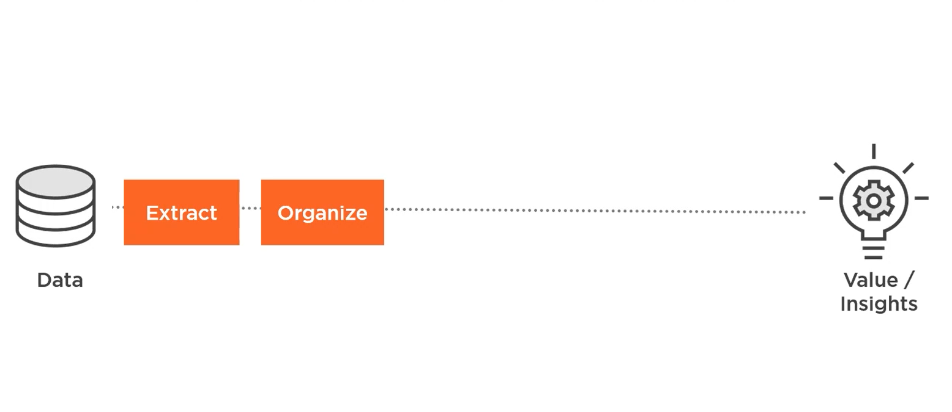
Data Science Project Cycle Overview

Slide 3
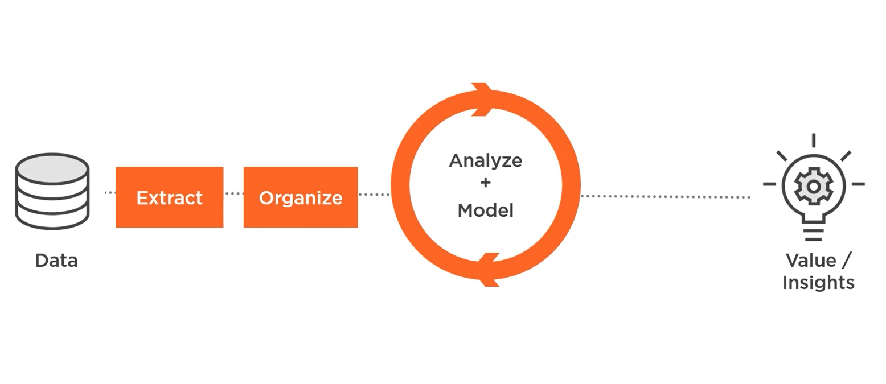
Data Science Project Cycle Overview

Slide 4
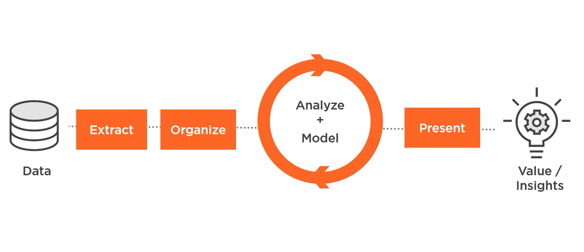
Data Science Project Cycle Overview

Slide 5
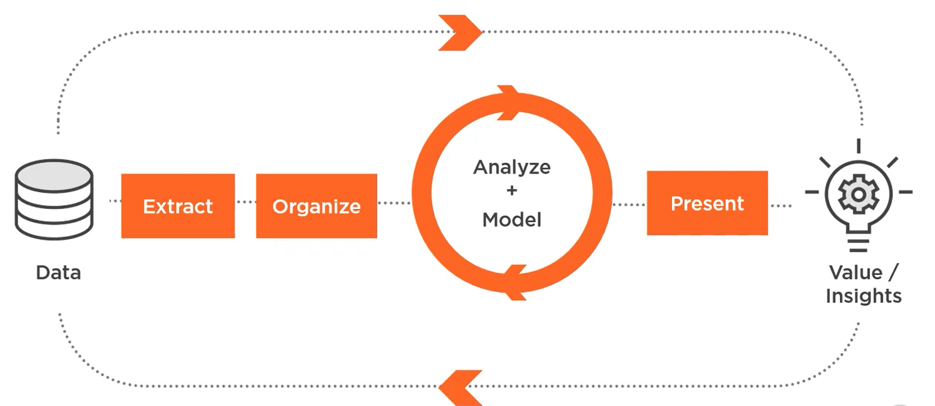
Data Science Project Cycle Overview

Slide 6
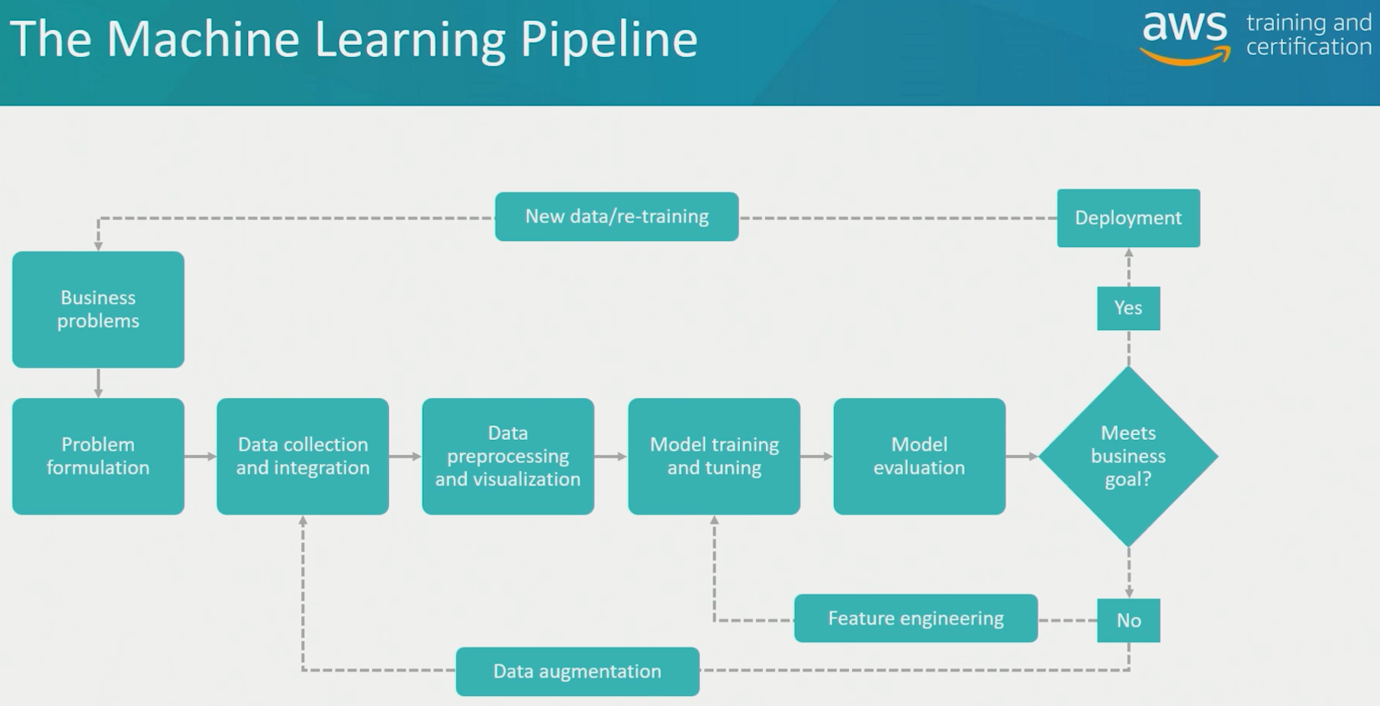

Slide 7
Terms
Features
Observations
Rectangular data
Time-series data
Cardinality
Cost function
Hyperparameters

Slide 8
Machine Learning
Arthur Samuel (1959): Field of study that gives computers the ability to learn without being explicitly programmed.

Slide 9
Machine Learning Problem – Example 1
Person | Years of experience | Salary
1 | 5 | 62
2 | 1 | 41
… | … | …
n | 16 | 105
New | 10 | ?

Slide 10
Machine Learning Problem – Example 2
Person | Tumor size | Tumor Type
1 | 5 | Malignant
2 | 3 | Benign
… | … | …
n | 8 | Malignant
New | 6 | ?

Slide 11
Machine Learning Problem – Example 3
Person | Age | Family Status | … | Profession | Approve Bank Loan
1 | 45 | Single | … | Carpenter | Yes
2 | 34 | Married | … | Programmer | No
… | … | … | … | … | …
n | 29 | Divorced | … | Taxi driver | No
New | 51 | Single | … | Engineer | ?
Notes:
Provide lots of examples to the machine. Training phase. Then provide it with the data for which you need to get the labels.

Slide 12
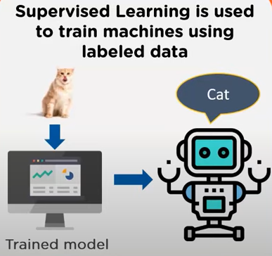
Types of Machine Learning Problems
Supervised learning – labels are provided to the machine during training.
Need human intervention

Slide 13
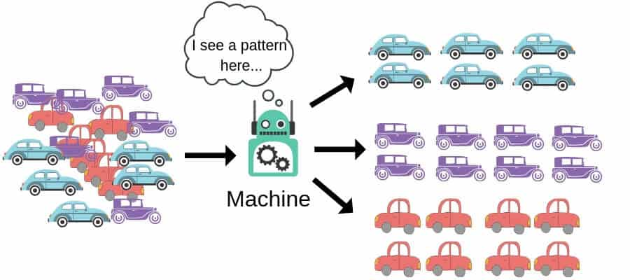
Types of Machine Learning Problems
Unsupervised learning – no labels are provided to the machine during training.
Do not need human intervention

Slide 14
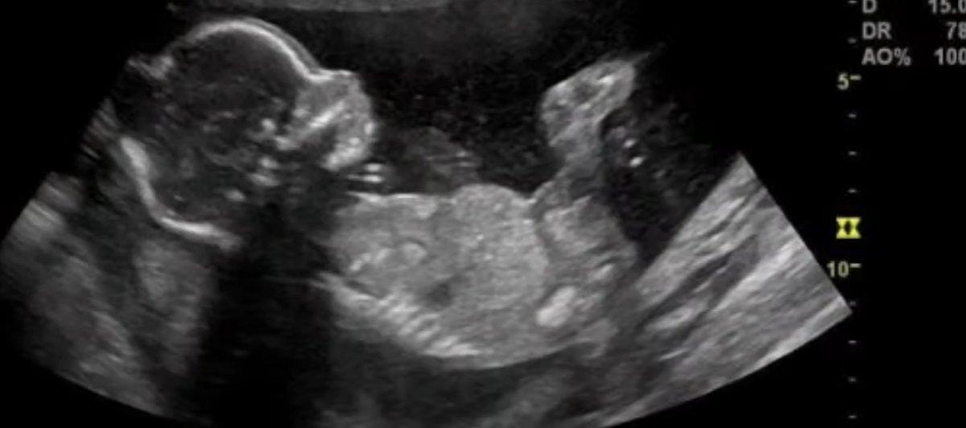
Types of Machine Learning Problems
Semi-supervised learning – labels are provided to some of the observations to the machine during training.
Need some human intervention

Slide 15
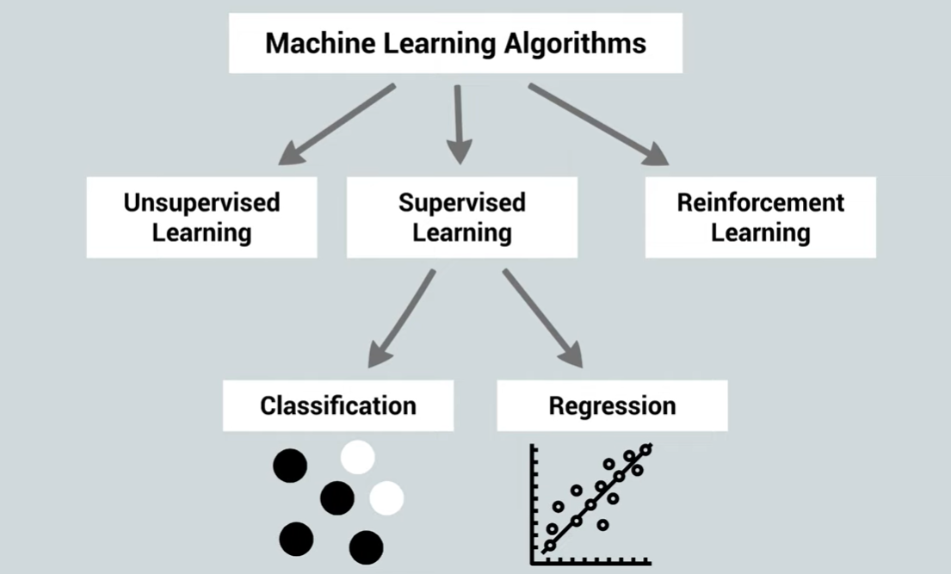
Types of Machine Learning Problems

Slide 16
Supervised Learning Types
Classification – output are classes / categories
Is there are car, human, dog in a given image
Approve bank loan
Is a tumor malignant / benign
Regression – output are numbers
Predict home prices
Number of T-shirts to be produced by a factory
Logistical Regression – binary output of 0/1 with probability
Heart attack
University admissions

Slide 17
Unsupervised Learning Types
Clustering
Customer segmentation
Association
Recommender systems
Dimension Reduction – for pre-processing data
Remove noise from images to improve picture quality

Slide 18
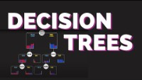
Supervised Learning > Decision Trees
https://www.youtube.com/watch?v=zs6yHVtxyv8

Slide 19
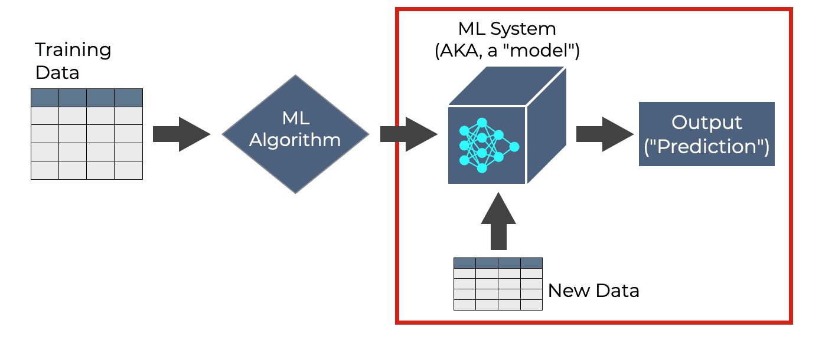
Machine Learning Process

Slide 20
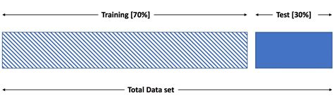
Train Test Data Split
X_train
y_train
ML Model
X_test
y_train_predict
y_test_predict

Slide 21
Supervised Learning > Decision Trees
Let’s try it out in Jupyter Notebook

Slide 22
Ensemble Models - Random Forest
Why only use one tree?
Why not build multiple trees and combine their outputs?
These types of models are called ensemble models.

Slide 23
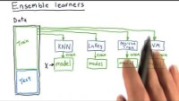
Ensemble Models
https://www.youtube.com/watch?v=Un9zObFjBH0

Slide 24
Supervised Learning > Classification > Random Forest
Let’s try it out in Jupyter Notebook

Slide 25
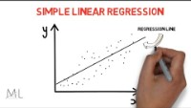
Supervised Learning > Regression
https://www.youtube.com/watch?v=HoqXask9cN8

Slide 26
Supervised Learning > Regression
Let’s try it out in Jupyter Notebook

Slide 27
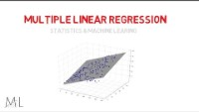
Supervised Learning > Regression
https://www.youtube.com/watch?v=SZ--3sUoNmY

Slide 28
Cost Function – used to calculate optimal parameters
Linear regression uses the equation:
y = w*x + b
For each observation (x), there is a corresponding output (y)
What should be the values of w and b so that the predicted outputs during training are as close to the actual outputs as possible for a given combination of w and b values?
How do we do this?
Using a cost or loss function such as root mean square of the difference between predicted and actual values.

Slide 29
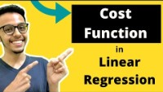
Cost Function
https://www.youtube.com/watch?v=yt7fzvwfWHs

Slide 30
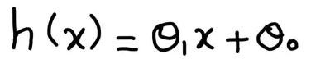
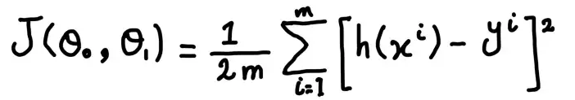
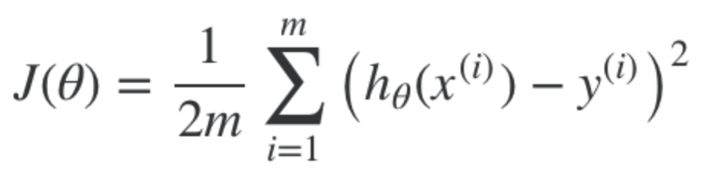
Generalized Cost Function
[For single feature]
h₀(x) = θ₀ + θ₁x₁ + θ₂x₂ + ……… θₙxₙ
[For multiple features]

Slide 31
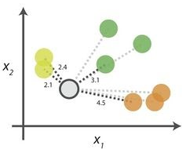
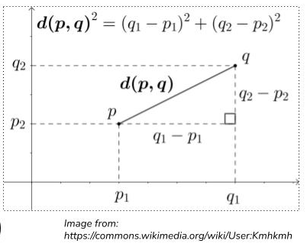
K Nearest Neighbors
Say T-shirt size (S, M, L) is to be determined using height and weight features
Using 2 features x1 & x2 (height & weight)
Set an odd value of k (typically 5)
Scale data - normalize
Calculate Euclidean (or Manhattan) distance of the new point from the nearest k neighbors.
Assign the new data point to the majority group
Note: No training required
Notes:
Can multi-dimensional data be plotted?

Slide 32
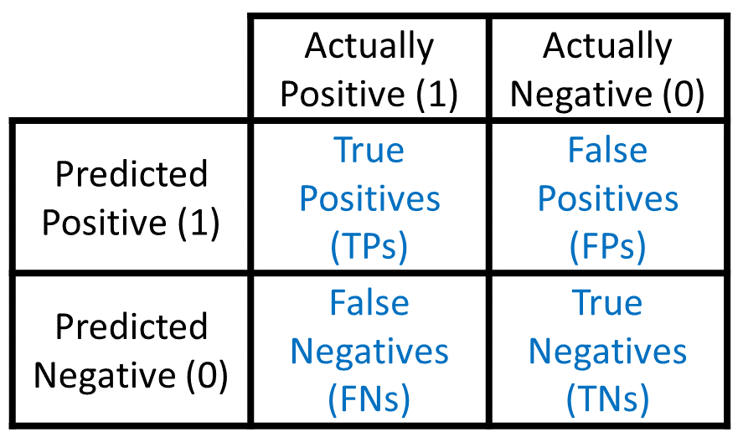
Confusion Matrix
Actual Values
When model predicted that a person has Covid, but actually does not have Covid.
Predicted Values
When model predicted that a person does not have Covid, but actually has Covid.
Notes:
Why is this problematic?

Slide 33
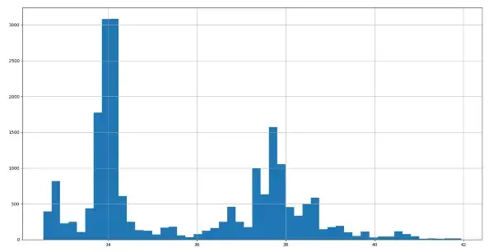
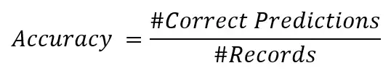
Confusion Matrix
Let’s say a dataset has three targets named “A”, “B”, and “C” skewed with 200, 30, and 20 records.
Say the predictions give 180, 20, and 10 correct predictions in each target.
Accuracy = 84% = (180+20+10)/(200+30+20).
Accuracy does not give an image of how bad “B” and “C” predictions are as they have individual accuracy of 66% and 50%.
Skewed Dataset
Notes:
Can multi-dimensional data be plotted?

Slide 34
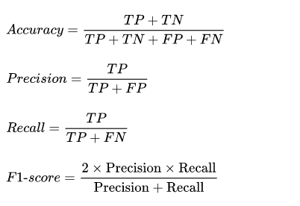
Confusion Matrix
Notes:
Can multi-dimensional data be plotted?

Slide 35
Confusion Matrix
Examples where high precision is needed:
Restricted model in YouTube to restrict the violent and adult videos for kids. So, model focus on high precision {TP/(TP+FP)} by reducing FPs. Meaning, if model has classified the video is good for kids it must be safe to watch by kids.
Classify a customer as shoplifter only when he/she is actually a shop lifter. Reduce FP => high precision {TP/(TP+FP)}.
Examples where high recall is needed:
Model to detect cancer in patient. The model must have high recall {TP/(TP+FN)} => reduce FNs. If model predicts a patient does not have a disease, he/she must not have the disease.
Model to detect if a loan applicant is not a defaulter. Model requires high recall {TP/(TP+FN)}. If the model detects that applicant is not a defaulter, the applicant must not be a defaulter.

Slide 36
Confusion Matrix
To overcome the precision recall tradeoff, use F1 score:

Slide 37
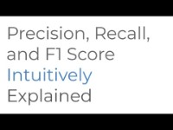
Confusion Matrix
https://www.youtube.com/watch?v=8d3JbbSj-I8

